Slide 1
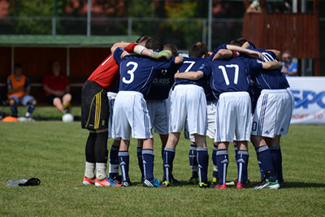
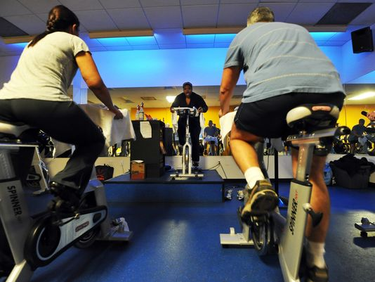
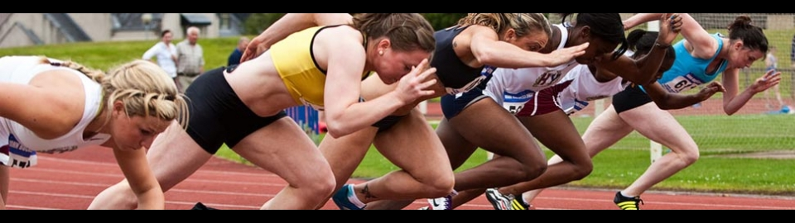


PHYSICAL ACTIVITY

Slide 2
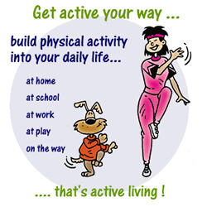
BENEFITS OF PHYSICAL ACTIVITY Physically active - Being healthy. Children and adolescents should do 60 minutes (1 hour) or more of physical activity daily.
Control your weight
Reduce your risk of cardiovascular disease
Reduce your risk for type 2 diabetes and metabolic syndrome
Reduce your risk of some cancers
Strengthen your bones and muscles
Improve your mental health and mood
Improves better Academic performance
Improve your ability to do daily activities and prevent falls, if you're an older adult
Increase your chances of living longer

Slide 3

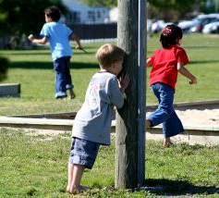
Types of physical activity
1. Aerobic Activities - bike riding, walking, running, dancing, and playing active games like tag, soccer, and basketball.

Slide 4

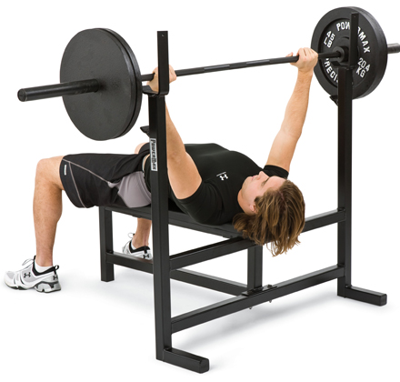

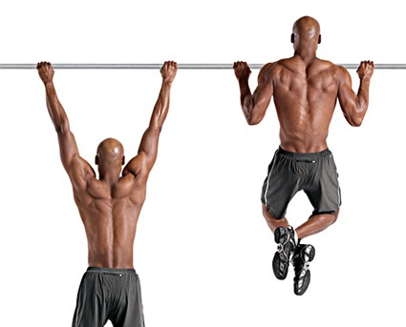
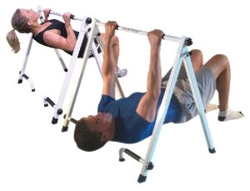
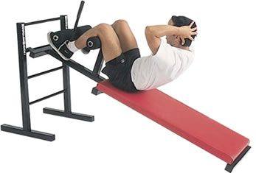
2. Muscle-strengthening Activities
Includes push-ups, pull-ups, and weightlifting exercises, climbing a tree.

Slide 5


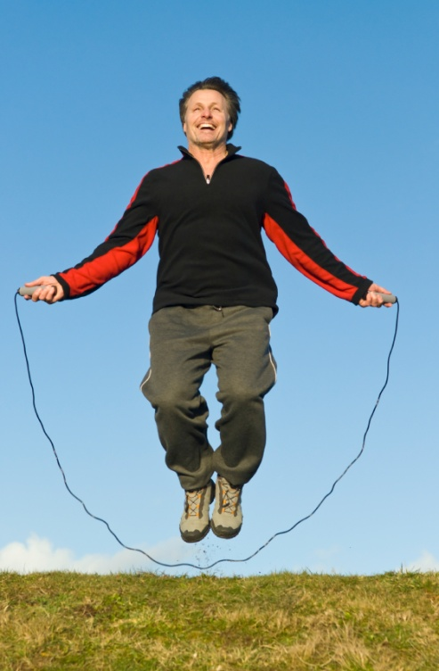
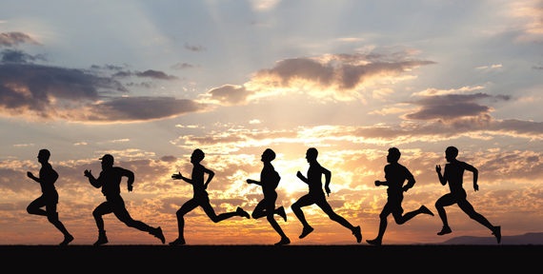
3. Bone-strengthening Activities
Includes hopping, skipping, jumping, running, and sports like gymnastics, basketball, and tennis.

Slide 6




SOME ACTIVITIES MAY ADDRESS MORE THAN ONE CATEGORY AT A TIME.
gymnastics is both muscle- strengthening and bone-strengthening.
Running is aerobic and bone-strengthening;
Swimming is a whole body exercise.

Slide 7
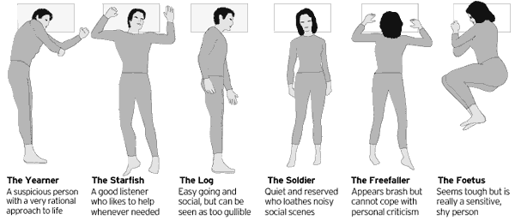
SLEEPING POSTURES

Slide 8
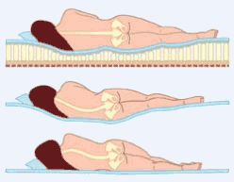

Slide 9
RESTING PATTERN AND POSTURES
Sleep or rest is a behavioral state that is a natural part of every individual’s life.
We spend about one-third of our lives asleep. Sleep is a required activity, not an option. Sleep is important for normal motor and cognitive function.
Problem sleepiness is associated with difficulty concentrating, memory lapses, loss of energy, fatigue, lethargy, and emotional instability.
The prevalence of problem sleepiness has serious consequences, such as drowsy driving or workplace accidents and errors.
Lifestyle factors and undiagnosed or untreated sleep disorders can cause problem sleepiness.
Lifestyle factors include not getting enough sleep, having an irregular sleep schedule, and using alcohol or certain medications, electronic usage at nights, waking late nights.

Slide 10
Of the more than 70 known sleep disorders, the most common are obstructive sleep apnea, insomnia, narcolepsy, and restless legs syndrome.
Approximately 100,000 automobile crashes each year result from young male drivers who were “asleep at the wheel.”
Alcohol does not promote good sleep, and consuming alcohol in the evening can also exacerbate sleep apnea problems.
Environmental noise, temperature changes, changes in sleeping surroundings, and other factors may affect our ability to get sufficient restful sleep.

Slide 11
SLEEP DISORDERS
Insomnia
Obstructive sleep apnea (OSA) is a potentially life-threatening disorder in which breathing is interrupted during sleep.
Restless legs syndrome (RLS) is a neurologic movement disorder that is often associated with a sleep complaint. People with RLS have unpleasant leg sensations and an almost irresistible urge to move the legs.
Narcolepsy is a chronic sleep disorder that usually becomes evident during adolescence or young adulthood and can affect both men and women. The main characteristic of narcolepsy is excessive and overwhelming daytime sleepiness (even after adequate nighttime sleep) at inappropriate times and places.
Parasomnias are sleep disorders that involve sleepwalking, sleep talking, enuresis (bed-wetting), and sleep terrors, which are NREM disorders that occur early in the night.

Slide 12
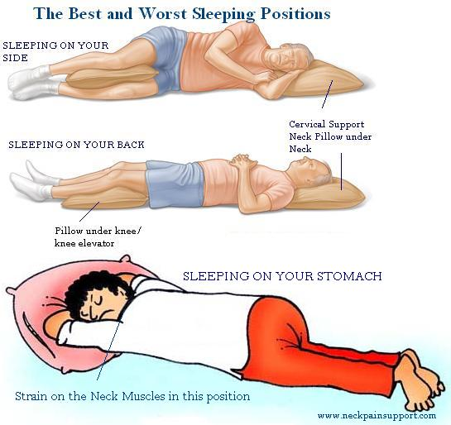
RESTING POSTURES
Each one of us would like to know how to sleep well so that we get up well-rested. A number of factors are involved in how to sleep well. One of the factors is our sleep posture. We all have a typical sleep posture and we feel comfortable when we sleep in that sleep posture.
On Your Back, Arms at Sides
On Your Back, Arms Up
Face Down
Fetal Position
On Side, Arms at Sides
On Side, Arms Out
On the Right Side
Pillow-Supplemented

Slide 13
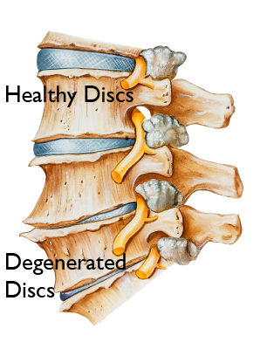
DEGENERATIVE DISC DISEASE
Degenerative disc disease is a "disease of aging", an age related disease causesing low back pain and neck pain. Over the years and decades, the repeated daily stresses on the spine and occasional minor, unnoticed injuries, as well as major ones, begin to take their toll.

Slide 14
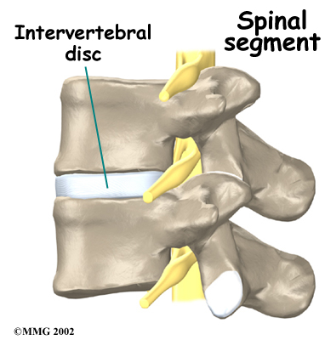
WHAT ARE THE INTER VERTEBRAL DISCS?
The intervertebral discs form the vertebrae's shock absorbers. They act as padding, and cushion the stress when the spine moves or bears weight. These spinal discs also help the spine bend and then bend back to its normal curves.
In a healthy young adult the intervertebral discs consist of about 90% water. As we age the water content goes down, the padding becomes less thick and the spine becomes slightly shorter as a result. Sometimes the disc might bulge.

Slide 15
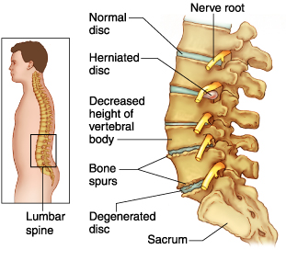

Slide 16

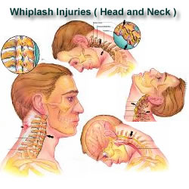
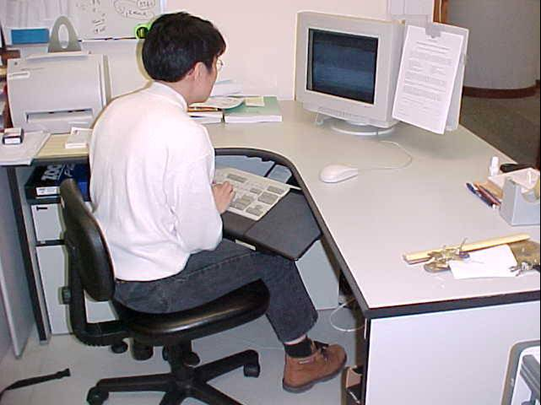

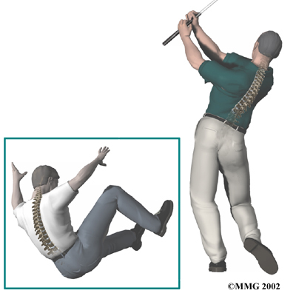
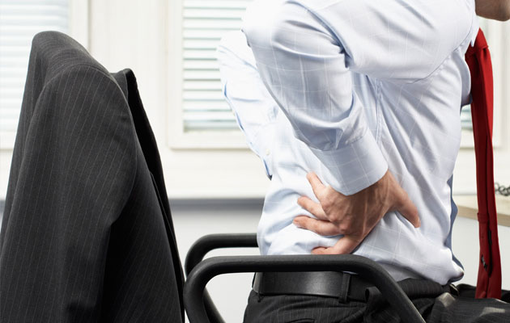

Slide 17

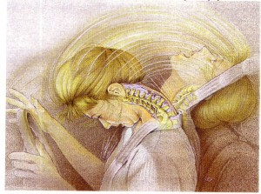
WHAT ARE THE CAUSE’S DEGENERATIVE DISC DISEASES?
As the human body ages, the intervertebral discs degenerate (break down), which leads to degenerative disc disease in some individuals.
Work postures
Sleeping postures
Aging-wear and tear
Loss of fluid
Disc structure is affected
Obese individuals- increased in weight
Tobacco smokers
Regular strenuous physical workers
An acute sudden injury or fall

Slide 18
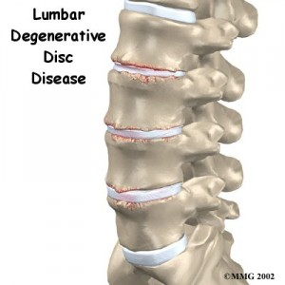
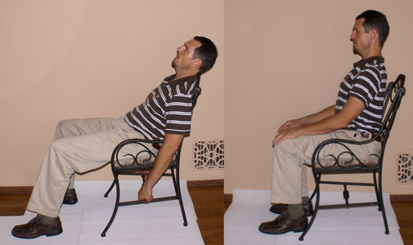
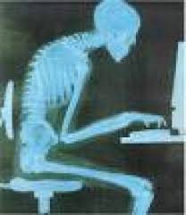
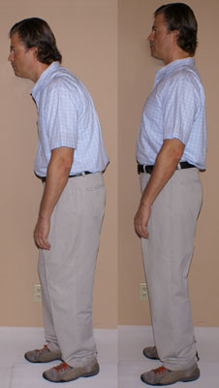
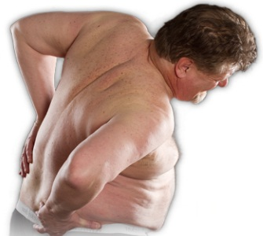

Slide 19
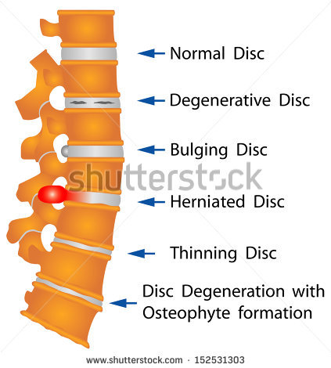
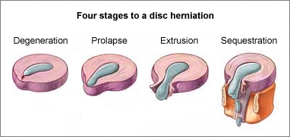
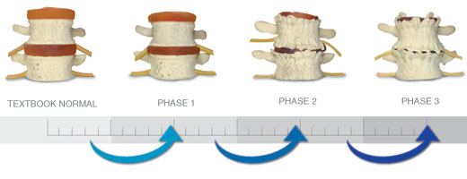

Slide 20
When the vertebrae have less padding between them the whole spine becomes less stable.
The body tries to cope with this by building osteophytes, also called bone spurs.
Bone spurs are small bony projections that develop along the edge of bones.
These projections can press against the spinal cord or spinal nerve roots, which undermine nerve function and cause pain.
There is a condition called spinal stenosis, which occurs when the bone spurs grow into the spinal canal and press into the spinal cord and nerves.
These conditions results due to lifestyle, postures while at work, sleep, etc, wear and tear, age related also.

